Slide 1
Verification of the Flat Plate Natural Convection Model
Tue 1pm - Group 1
Luke Bailey, Alan Herbst, Randy Saintjean, Irving Zhang

Slide 2
Content
Motivation & Background
DoE & Set up
Analysis & Results
Discussion
Future Directions and Improvements

Slide 3
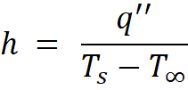
Motivation & Background
Heat transfer occurs via conduction, convection, radiation
Focus of this project: natural convection
Natural convection caused by buoyancy due to temperature gradients
Goal: experimentally estimate convection coefficient h
heat flux [W/m²]
ambient temperature [K]
surface temperature [K] ​
​
*As we are interested in the temperature gradient​, units of °C or K can be used, but cannot be mixed
​

Slide 4
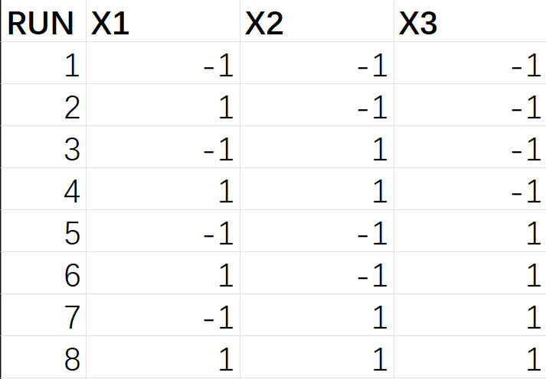
Design of Experiments
X1: T_{s} (hot plate temperature)
Low: 60 °C
High: 100 °C
X2: Box Size
Low: Small
High: Large (16"x20"x20")
X3: Angle of hot plate surface
Low: 0° (flat/horizontal)
High: 90° (vertical)

Slide 5
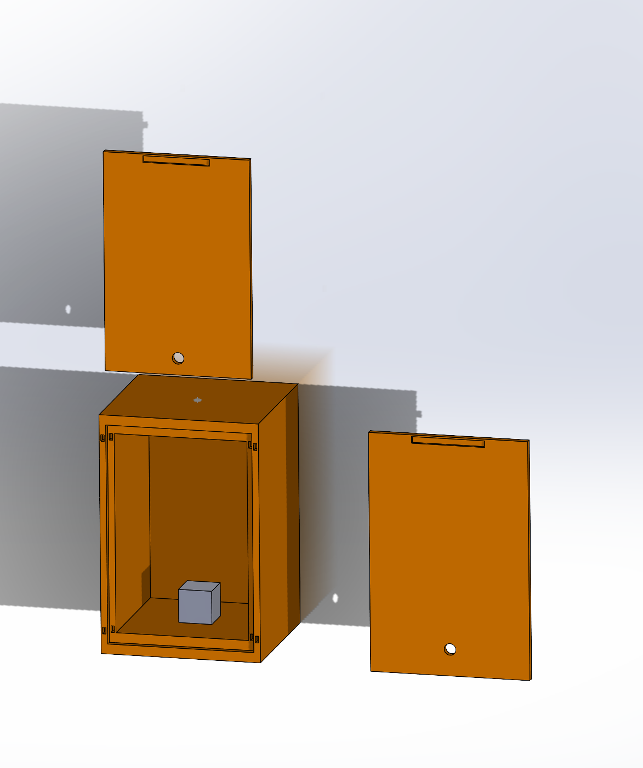
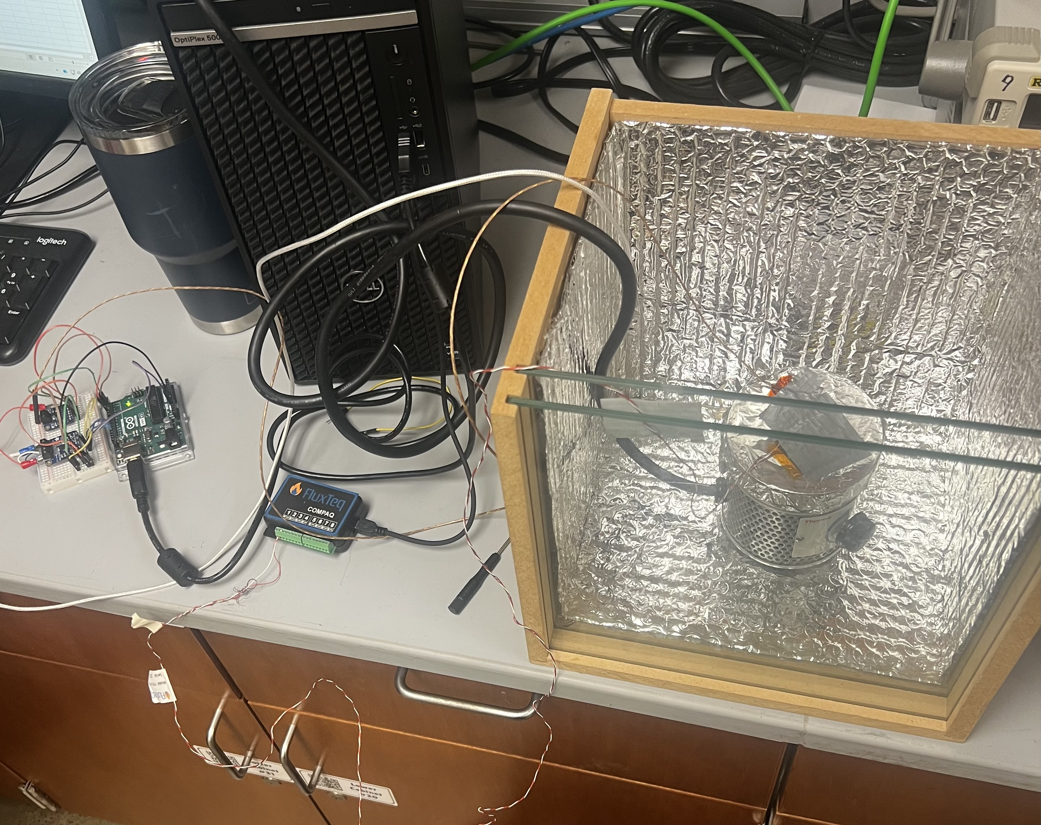
Test Set up
Main System components
insulated enclosure
Air-sealed open-top cardboard box : low-cost, easy-setup option. Safe for low-temperatures.
Custom wooden enclosure with double-pane setup was used for testing
hot plate
heat flux sensor
thermocouple
RTD
Arduino + DAQ

Slide 6
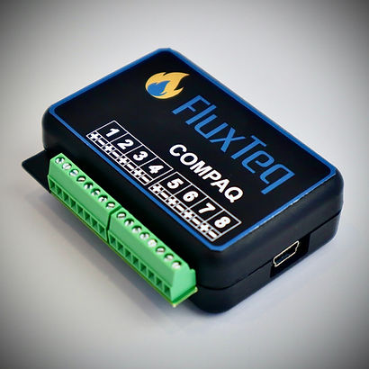
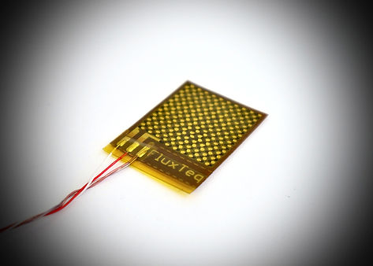
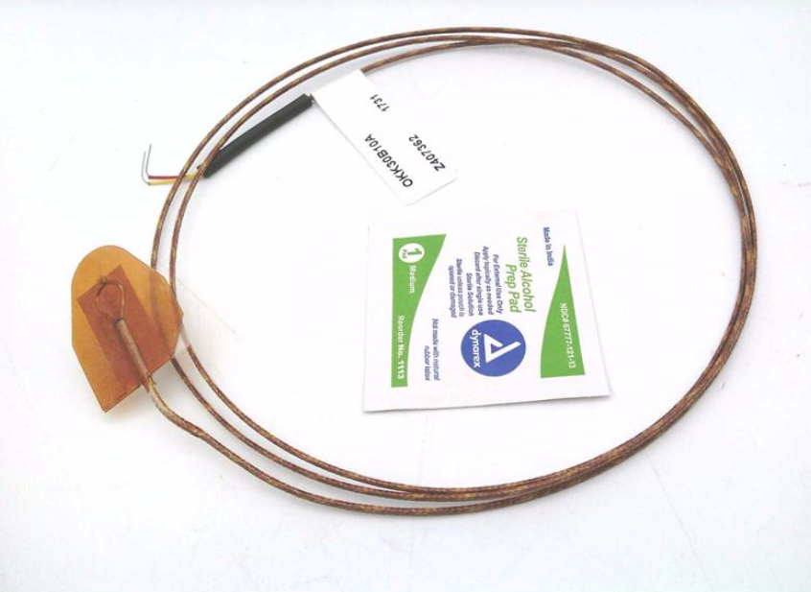
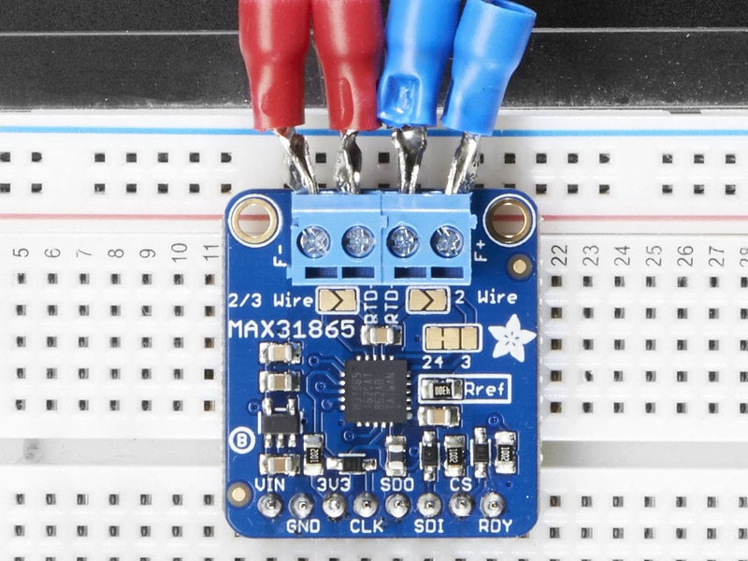
Sensors and Measurements
FluxTeq Compaq DAQ and PHFS-01
Measure actual heat flux (W/m^2)
Watlow OKK30B10A
Measure T_s (hot plate) (°C)
Adafruit PT100 RTD and MAX31865 Amplifier
Measure T_∞ (ambient box temperature) (°C)

Slide 7
DAQ & Analysis
Calibration
RTD
Submerge directly in ice bath – average offset based on series of readings
OKK30B10A
Enclose within plastic bag before submerging in ice bath (no liquid exposure) – average offset based on series of readings
PHFS-01
Attach to rated heater – average offset based on series of readings
Two-hotplate, conduction "sandwich" method
What to collect
RTD – T∞ [°C]
OKK30B10A – T_{s} [°C]
PHFS-01 – heat flux [W/m² ]
How to analyze the data
Compare calculated average convection coefficient for each factor combination to expected convection coefficient range with t-test (α=0.05)
Left tailed test for lower bound of heat flux range
Null hypothesis- h >= h_lower
Alternative hypothesis- h< h_lower
Right-tailed test for upper bound of heat flux range
Null hypothesis- h <= h_upper
Alternative hypothesis- h> h_upper
Multiple Comparison Analysis (Dunn-Sidak) to determine which combinations are statistically different
Main and Interaction Effects Full-Factorial Analysis

Slide 8
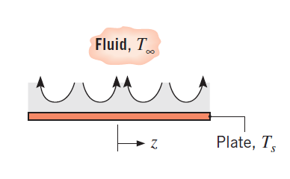
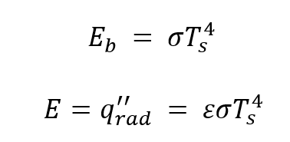
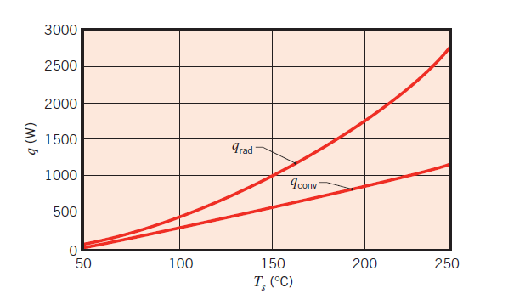

Heat Transfer Model
Affects of other heat transfer modes
Conduction and forced-convection:
Negligible or not present within design
Radiation:
Non-negligible, must be accounted for
Overlaying known low-emissivity Al. Foil (𝜀 = 0.03) enables radiative flux to be subtracted from measured flux
Bergman et al., Fundamentals of Heat and Mass Transfer 7ed, 2011
Bergman et al., Fundamentals of Heat and Mass Transfer 7ed, 2011

Slide 9
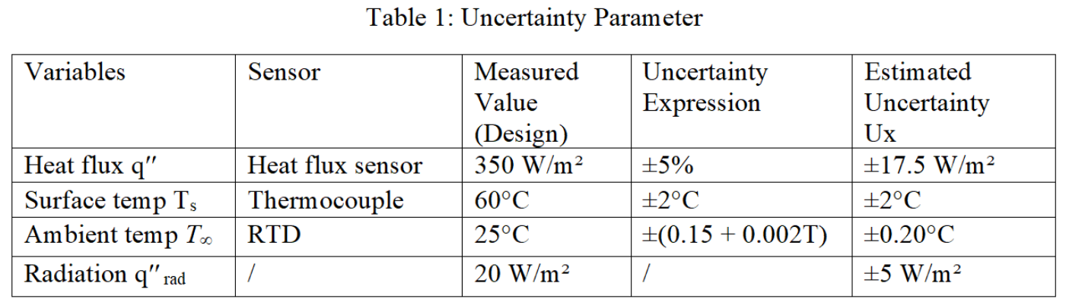
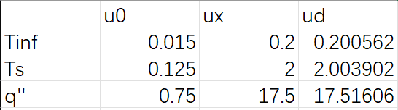

Uncertainty
Design Stage
Zeroth Order
T_{s} sensor Resolution: 0.25°C
T∞ sensor Resolution: 0.03°C
Heat flux sensor Res: ≈ 1.5 W/m^2
Dominant source: surface temperature (thermocouple)
Uncertainty ↑ when ΔT ↓
Thus, operate at larger temperature difference
Uhd = 0.73 W/(m²K)​
U_{ho} = 0.04 W/(m²K)

Slide 10
Sample Data
Model confirmation!

Slide 11
Discussion
Pros
Easy to construct and adjust
Cut and add cardboard
Seal holes and gaps with duct putty
Low cost
Sensors readily available
Removes air flow and outside disturbances
Cons
Accounts for relatively few properties affecting convection
Unaccounted for variations in convection coefficient
Some variables affecting convection cannot be easily adjusted
E.g. orientation of hot plate
Irregular, time-sensitive temperature gradient
Ambient temperature changes with distance from plate
Temperature gradient will decrease over time
Various influences on convection not isolated
Future work
More flexible enclosure that allows for measuring more variables affecting convection
E.g. heat plate orientation, geometry, flow characteristics

Slide 12
Future Directions and Improvements
More flexible enclosure that allows for measuring and assessing additional convection-related variables
E.g. heat plate orientation, geometry, flow characteristics
Improve measurement quality
E.g. ensure flat, complete contact between plate + foil and foil + sensors
Fully-enclose the system to assess dynamics of time-varying temperature gradient
Generalize and apply approach to common engineering designs
Measuring and optimizing h-values may improve common products
Electronics (desktop PCs), ovens, radiators, building design/cooling, etc.

Slide 13
Appendix & Credits
References:
Cengel and Boles, Thermodynamics: An Engineering Approach, 5th edition, McGraw-Hill, 2006.
Bergman, Lavine, Incropera, and Dewitt, Fundamentals of Heat and Mass Transfer, 7th Edition, John Wiley and Sons, 2011
Vipperman, J., “Lab 2 Handout - Insulation R-Value of Single-Pane and Dual-Pane Windows”, University of Pittsburgh, 2026.
Arduino, "Adafruit MAX 31855 library," Arduino Documentation, Nov., 15, 2023
Arduino, "Adafruit MAX 31865 library," Arduino Documentation,Nov., 15, 2023

